Slide 1
Code structure: From OOP to Design Pattern and MVC Pattern
CoEs
.

Slide 2





Agenda
Introduction
OOP recap
From OOP to MVC Pattern
Introduction to Design pattern
Summarize
Q&A

Slide 3

ABOUT ME
Nguyễn Lê Nhật Trường
B.Sc in Software Engineering by FPT University, graduated in 2019
Full-stack .Net Developer with 9 years of experience
Mentor for Laboratory courses in FPT University.
I started in Netcompany in November 2020 as a consultant:
Developer and technical leader for a UK project.
Today, I’m a senior architect for Netcompany Vietnam.

Slide 4

About me
Dương Hiếu Nghĩa
Studied at University of Economics, HCMC
Discovered my interest in coding and decided to make the change.
6 years of experience working as Fullstack Developer. ReactJS, Angular, Golang, NodeJS, .Net, Java.
I started working for Netcompany Vietnam since October 2022 as Senior Consultant.

Slide 5

About me
Cao Nguyễn Hoàng Hiệp
Studies Software Engineering at FPT University HCM (K16)
Member of F-Code
Consultant for Netcompany Vietnam since September 2022

Slide 6
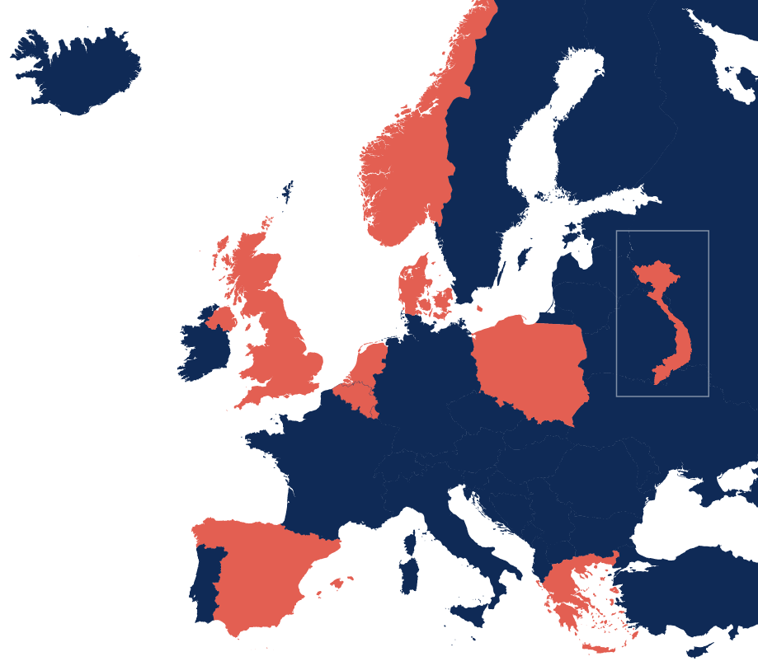
Netcompany at a glance
Norway
Netcompany is one of Europe’s fastest growing and most successful IT services companies, leading the way in showing how digital transformation can create strong, sustainable societies, successful companies and better lives for us all.
Our ambition is to become the market leader within IT services in Europe. The acquisition of Intrasoft in 2021 has strengthened our foundation to achieve that ambition - further expanding our portfolio of platforms and unique expertise across sectors with a global headcount of +7,400 talented employees.
By building flexible, scalable and secure digital platforms, Netcompany is positioned to help Europe thrive through a decade of massive digitisation.
Vietnam
Denmark
UK
Netherlands
Poland
Belgium
Luxembourg
Greece
Netcompany Core
3.8bn
Revenue (DKK) in 2022
+20%
Avg. revenue growth
for +10 years
+4,100
Employees year-end 2022
Spain
Netcompany-Intrasoft
Primary markets and locations
1.7bn
Revenue (DKK) in 2022
+8%
Avg. revenue growth
for +10 years (+12% in 2022)
+3,200
Employees year-end 2022
Additional offices in:
Romania | Cyprus | Jordan | Kenya | South Africa

Slide 7
PREFERRED PROVIDER OF END-TO-END
SERVICES
Innovation approach
Agile and solid execution
We know what it takes to build, operate and maintain IT solutions across all sectors and industries.
We constantly challenge and innovate, and ensure that Development and Operations work together to ensure stability with speed.
Code Plan Build
Test
Deploy
Operate
Monitor
Release
Through true DevOps

Slide 8
Agenda
Introduction
OOP recap
From OOP to MVC Pattern
Introduction to Design pattern
Summarize
Q&A
Notes:
We going to spend the rest of the afternoon to let you experience some of the secrets behind the most successful IT business in Scandinavia
First, we will give you a small piece of insight into working in Netcompany and a bit of information about the company profile
But what is it we do, and how do we do it better than our competitors
The goal of the afternoon is to give you an impression of how it is to work in a Netcompany team, and we are going to do that by working on a real life case.

Slide 9
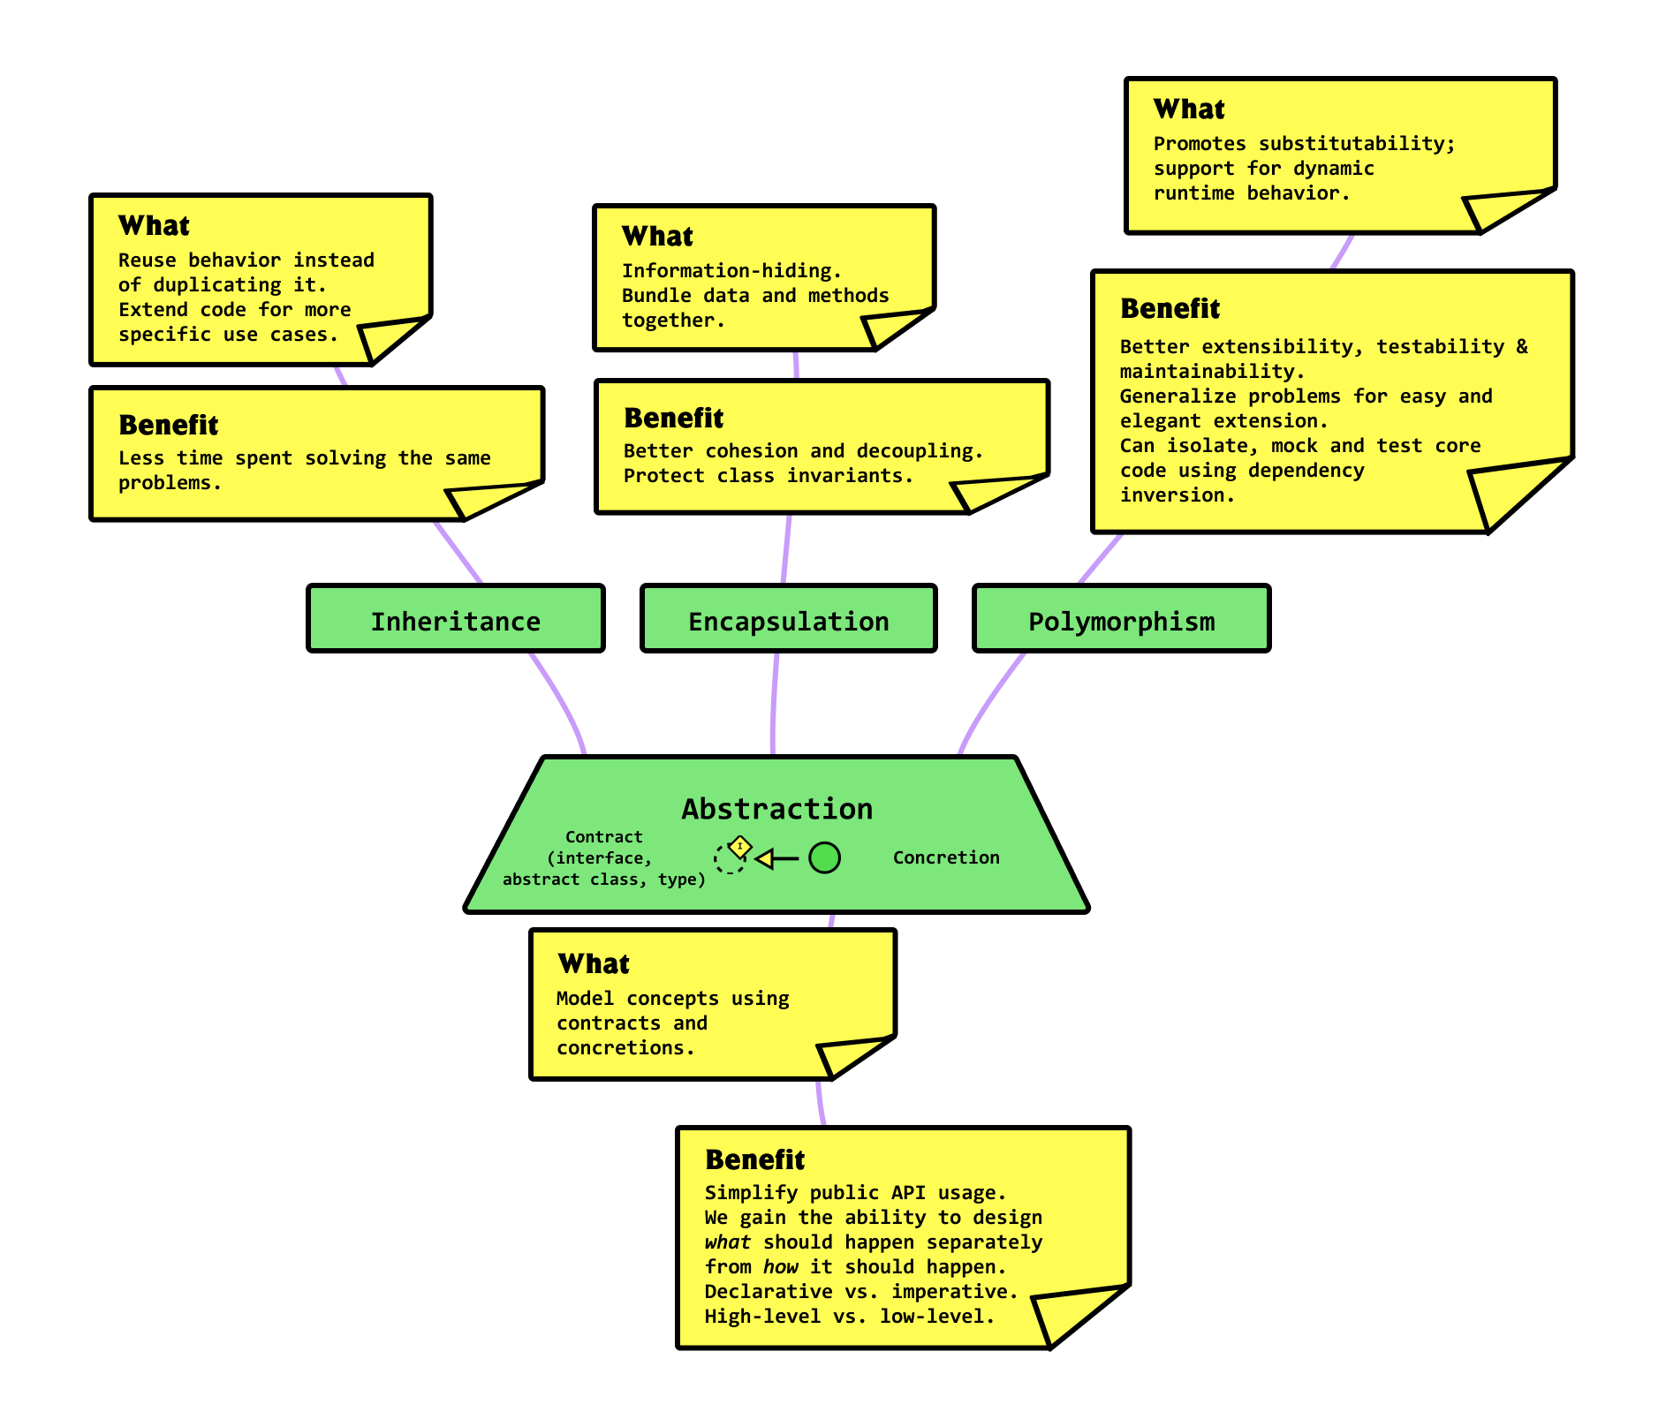
OOP Recap

Slide 10
OOP Recap
Well-organized project
Easier to locate the issue
Easier to find and re-use a logic
Loosing the coupling and increase cohesion
Increase the complexity

Slide 11

OOP Recap
Increase the complexity
How can we maximize the benefit of OOP
without over-complicated the code structure?

Slide 12
Agenda
Introduction
OOP recap
From OOP to MVC Pattern
Introduction to Design pattern
Summarize
Q&A
Notes:
We going to spend the rest of the afternoon to let you experience some of the secrets behind the most successful IT business in Scandinavia
First, we will give you a small piece of insight into working in Netcompany and a bit of information about the company profile
But what is it we do, and how do we do it better than our competitors
The goal of the afternoon is to give you an impression of how it is to work in a Netcompany team, and we are going to do that by working on a real life case.

Slide 13
From OOP to MVC Pattern
Case study
Definition & Motivation
Real world examples

Slide 14
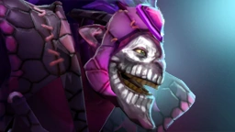
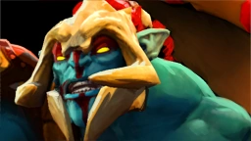
The case study
Greeting again with Dazzle and Huskar
Both finished the OOP course last semester.
Learned how to design an application using OO paradigm via their last project.
Hungry to practice more about OO design and OO programming.

Slide 15
The case study
They are building a console application
Provide a portal where club members can browse and sign up for club’s activities
Help club organizers manage their members and activities
Identify user by username-password login mechanism
May expand in future to cover for other management tasks of organizers
May increase number of roles and separate the responsibility of each tasks for each role
May transform into a web application later on
They tend to invite more developers to join the project
The team could be divided into two sub-team to take care of UI design and business logic better.

Slide 16
The case study
The first version
Main menu
Login menu
Organizer dashboard
Manage users
View user
Update user
Member dashboard
View profile
Update profile

Slide 17
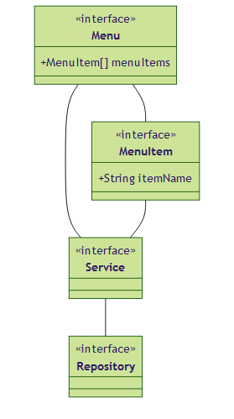
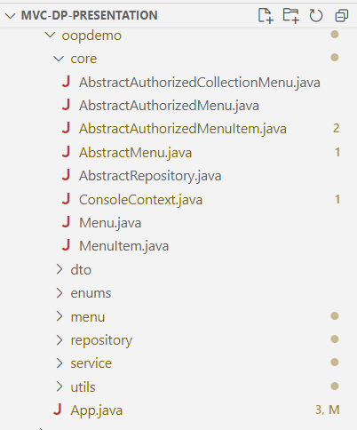
The case study
The first version

Slide 18
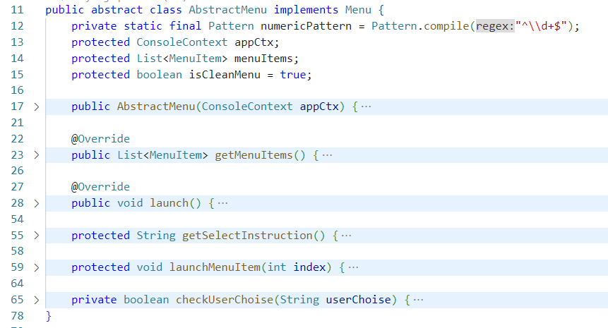
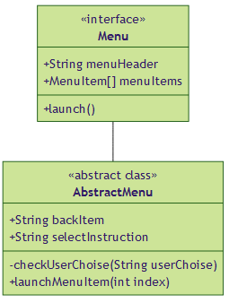
The case study
The first version

Slide 19
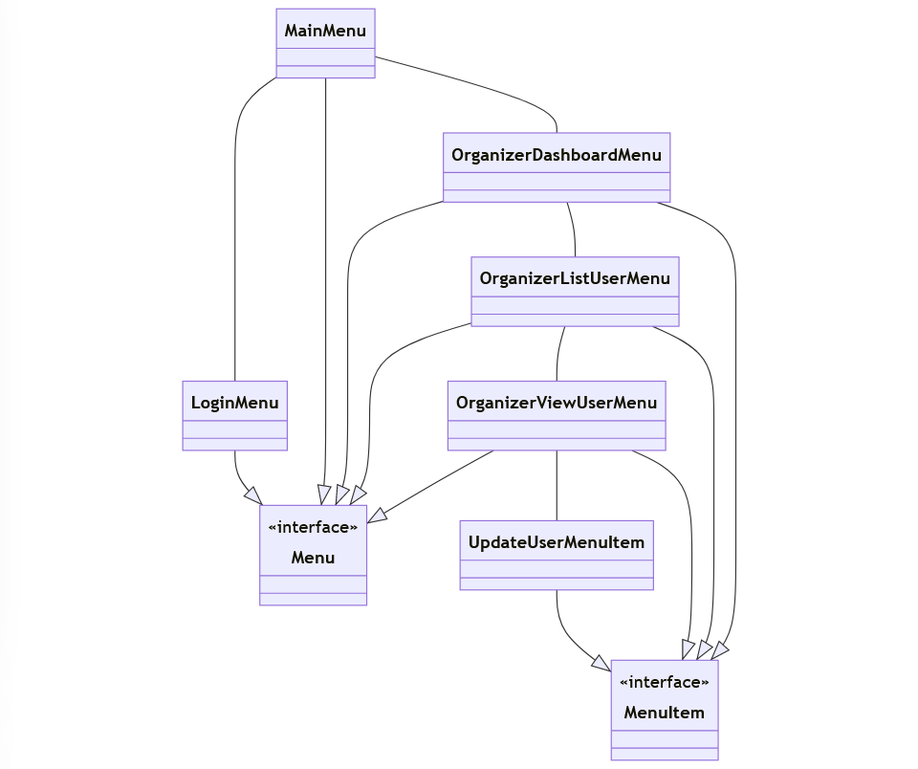
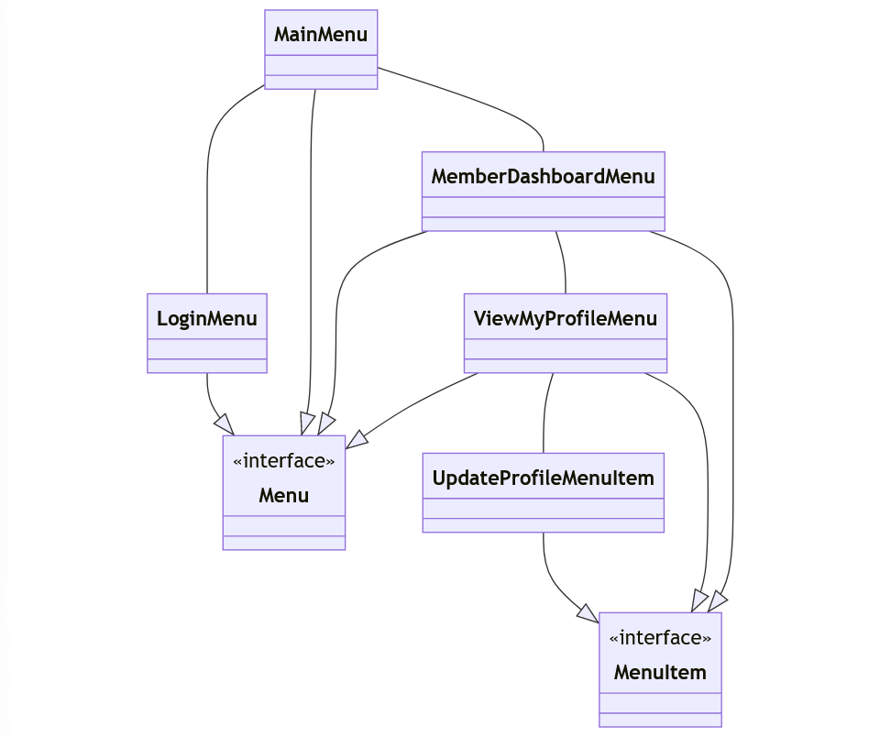
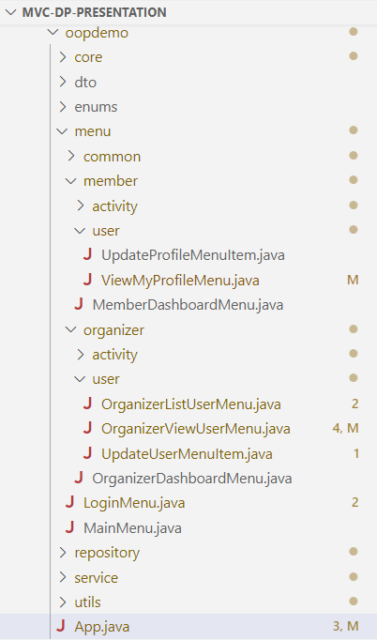
The case study
The first version

Slide 20
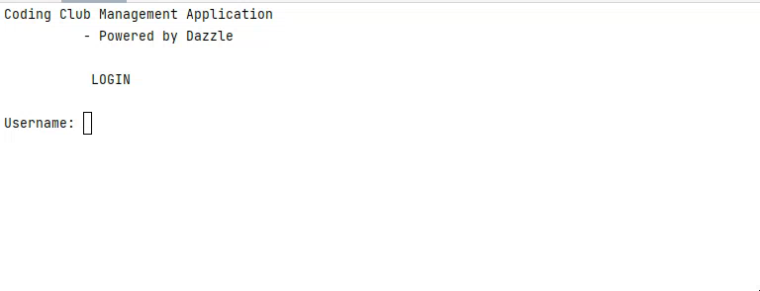
The case study
The first version
Member journey

Slide 21
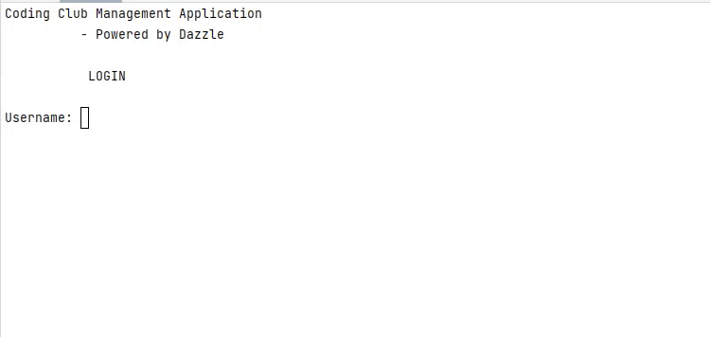
The case study
The first version
Organizer journey

Slide 22
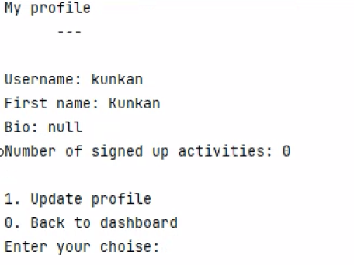
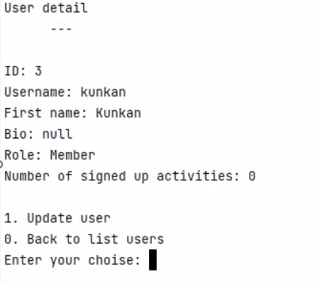
The case study
The context:
Each role could have a very different view for a same data model

Slide 23
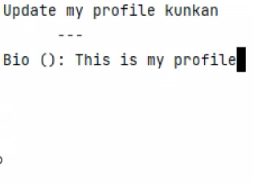
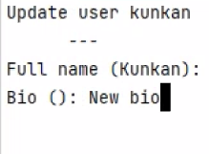
The case study
The context:
Each role could have a very different view for a same data model

Slide 24
The case study
The context:
Each role could have a very different view for a same data model
Different views could have some interactions in common

Slide 25
The case study
The first version
Main menu
Login menu
Organizer dashboard
Manage users
View user
Update user
Member dashboard
View profile
Update profile

Slide 26
The case study
The context:
Each role could have a very different view for a same data model
Different views could have some interactions in common
➔ The specification of each view class could cause the fragmentation of the logic codes

Slide 27
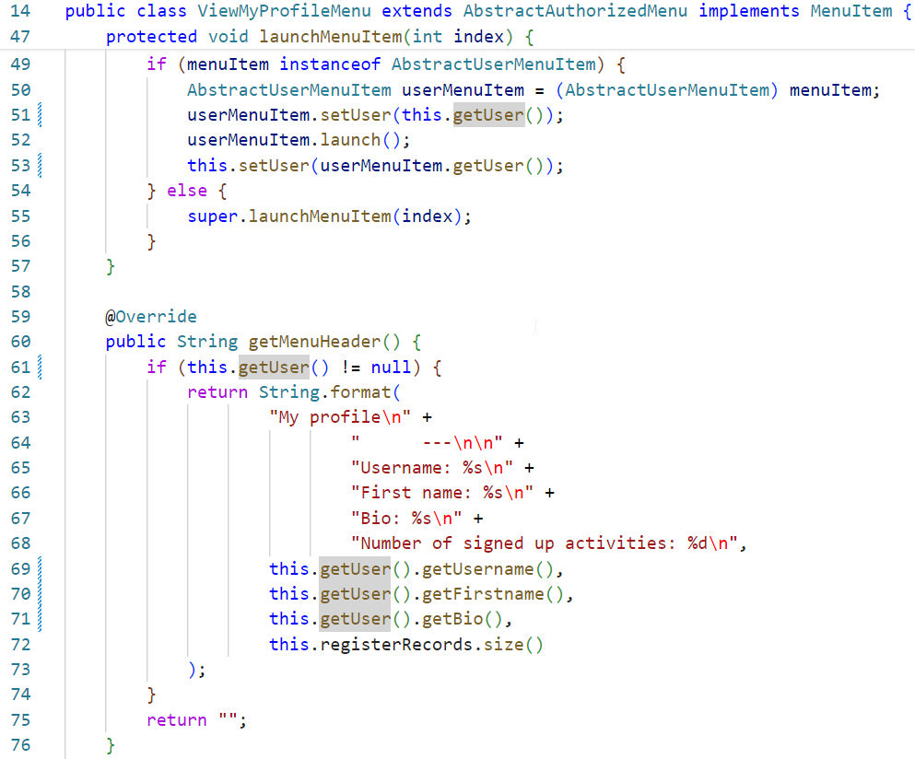
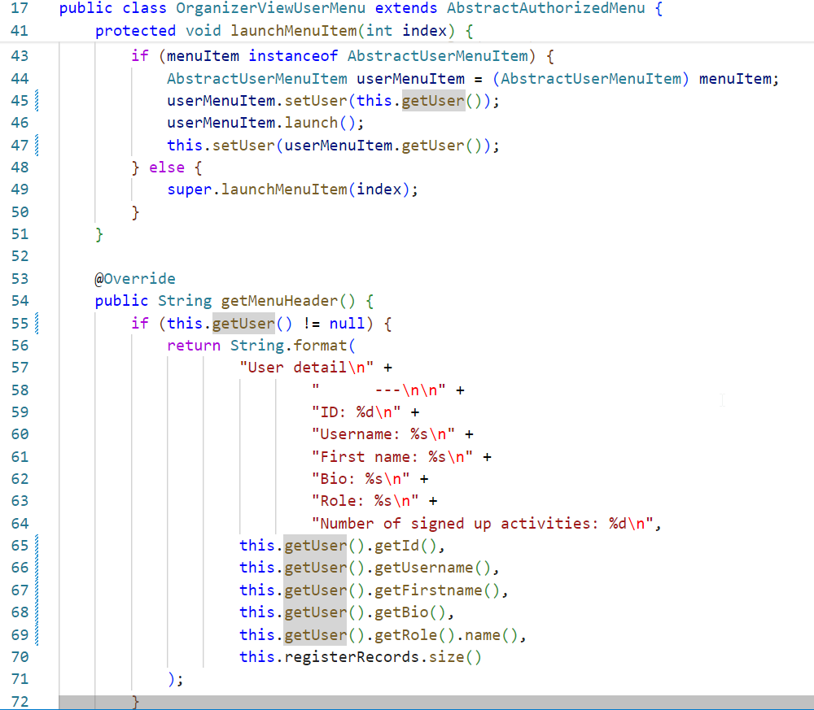
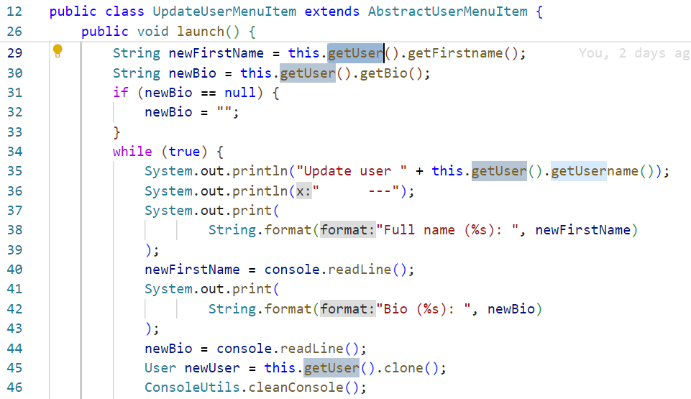
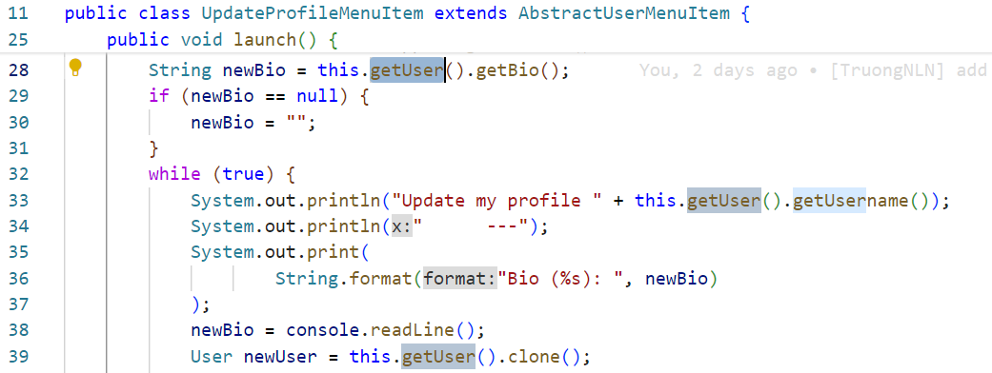
The case study
The first version
Main menu
Login menu
Organizer dashboard
Manage users
View user
Update user
Member dashboard
View profile
Update profile

Slide 28
The case study
The first version
Main menu
Login menu
Organizer dashboard
Manage users
View user
Update user
Member dashboard
View profile
Update profile

Slide 29
The case study
The first version
Main menu
Login menu
Organizer dashboard
Manage users
View user
Update user
Member dashboard
View profile
Update profile

Slide 30
The case study
The first version
Main menu
Login menu
Organizer dashboard
Manage users
View user
Update user
Member dashboard
View profile
Update profile

Slide 31
The case study
The planned second version
Main menu
Login menu
Organizer dashboard
Manage users
View user
Member dashboard
View profile
Update profile
Manage activity
View activity
Update activity
List activity
View Activity
Sign up
Sign out
Update user

Slide 32
The case study
The planned second version
Main menu
Login menu
Organizer dashboard
Manage users
View user
Member dashboard
View profile
Update profile
Manage activity
View activity
Update activity
List activity
View Activity
Sign up
Sign out
Update user

Slide 33
The case study
The planned second version
Main menu
Login menu
Organizer dashboard
Manage users
View user
Member dashboard
View profile
Update profile
Manage activity
View activity
Update activity
List activity
View Activity
Sign up
Sign out
Update user

Slide 34
The case study
The planned second version
Main menu
Login menu
Organizer dashboard
Manage users
View user
Member dashboard
View profile
Update profile
Manage activity
View activity
Update activity
List activity
View Activity
Sign up
Sign out
Update user

Slide 35
The case study
The context:
Each role could have a very different view for a same data model
Different views could have some interactions in common
The specification of each view class could cause the fragmentation of the logic codes
Coupling between UI render codes and logic codes

Slide 36
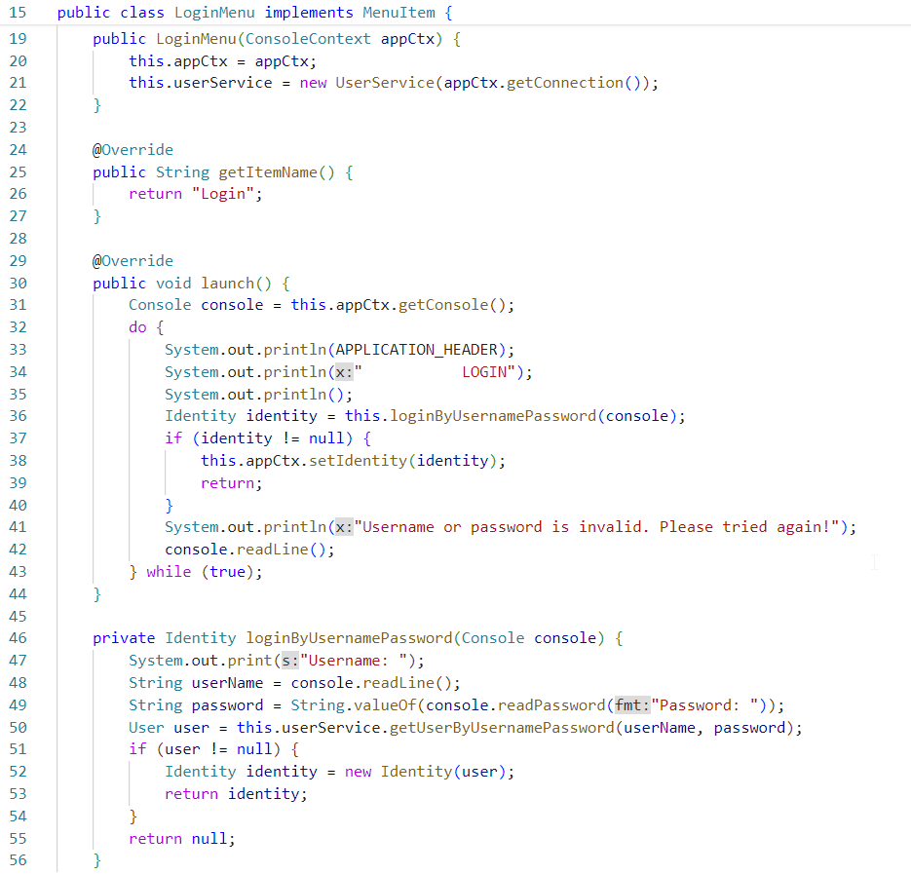
The case study

Slide 37
The case study

Slide 38
The case study
The context:
Each role could have a very different view for a same data model
Different views could have some interactions in common
The specification of each view class could cause the fragmentation of the logic codes
Coupling between UI render codes and logic codes
➔ Hard to sperate a task for UI design and business logic teams
Any tactical design to adapt this case study

Slide 39
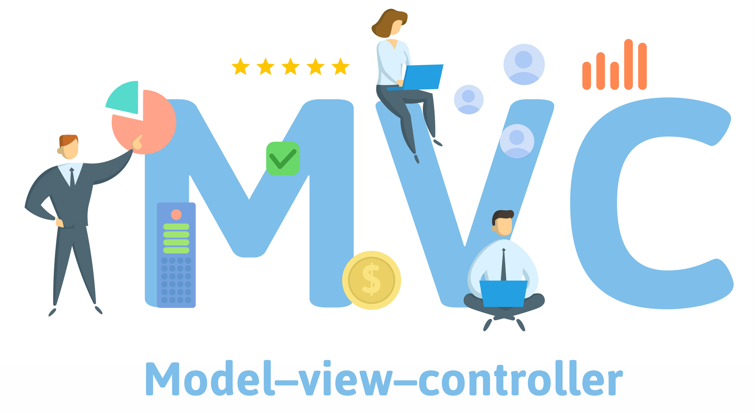
The case study

Slide 40
Definition & Motivation
Traditionally used for desktop graphical user interfaces (GUIs), this pattern became popular for designing web applications. Popular programming languages have MVC frameworks that facilitate the implementation of the pattern.

Slide 41
Definition & Motivation
Model-View-Controller is the concept of encapsulating
some data together with its processing (the MODEL)
and isolate it from the manipulation (the CONTROLLER)
and presentation (the VIEW) part that has to be done
on a User Interface.

Slide 42
Definition & Motivation
A MODEL is an object representing data or even activity, e.g. a database table or even some plant-floor production-machine process.
A VIEW is some form of visualization of the state of the model.
A CONTROLLER offers facilities to change the state of the model.

Slide 43

Definition & Motivation
the MODEL is the data, the VIEW is the window
on the screen, and the CONTROLLER is
the glue between the two.
Connelly Barnes

Slide 44
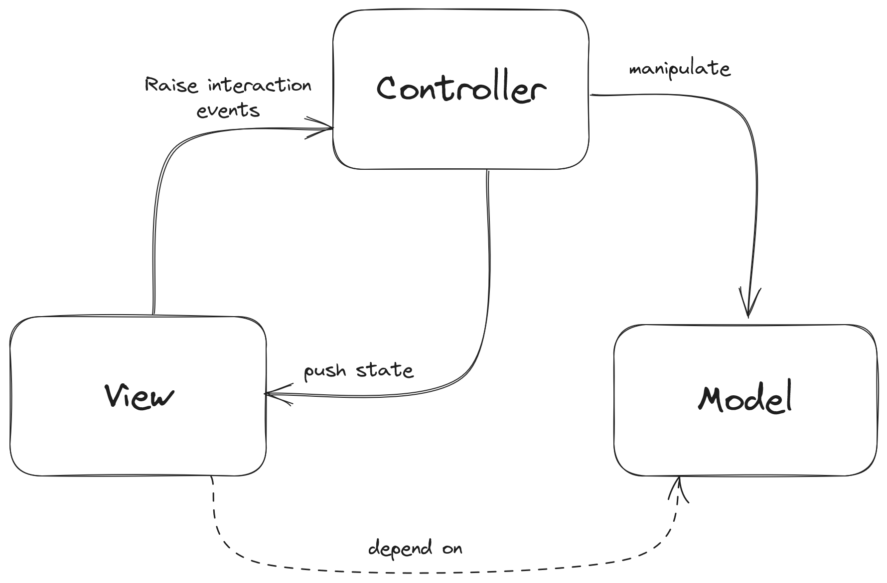
Definition & Motivation

Slide 45

Definition & Motivation
The Controller does not oversee the operation
of the Views and Models - it's not a GodClass.
The controller mediates communication
and unifies validation, using either direct calls
or the ObserverPattern.

Slide 46
Definition & Motivation
EventArg
Action

Slide 47
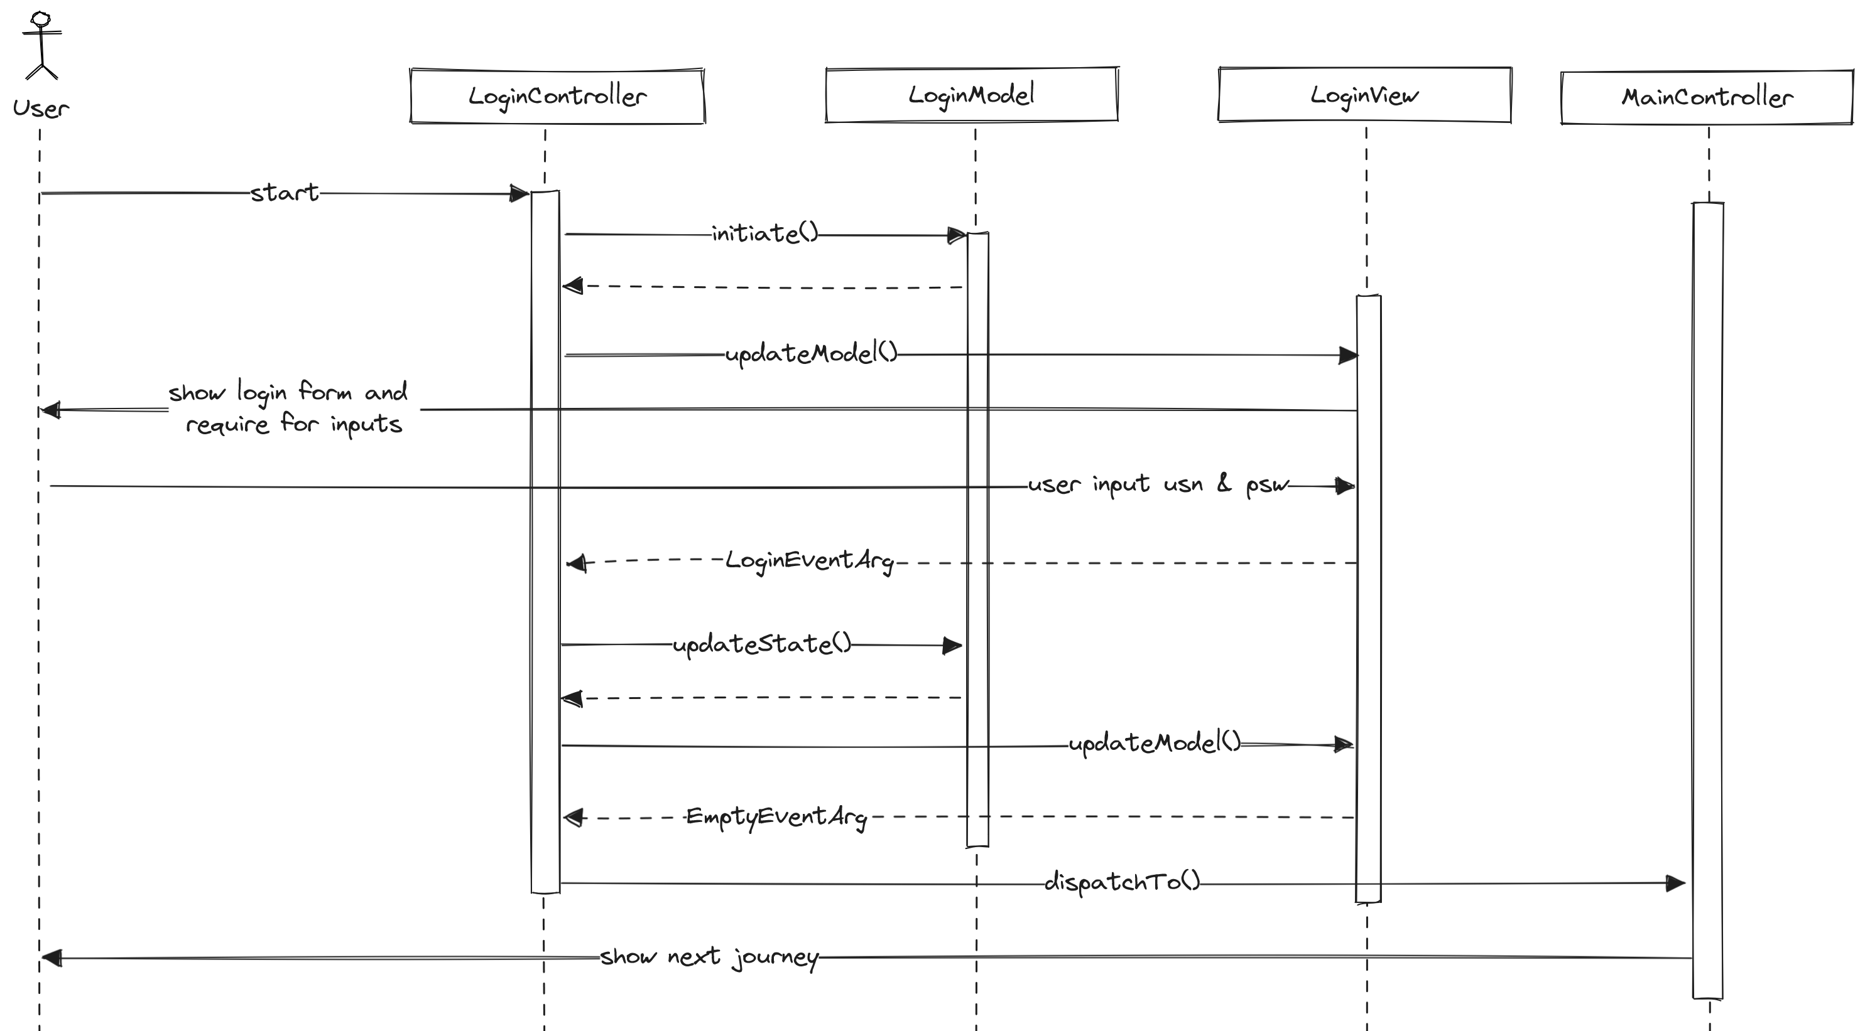
The case study

Slide 48
The case study

Slide 49
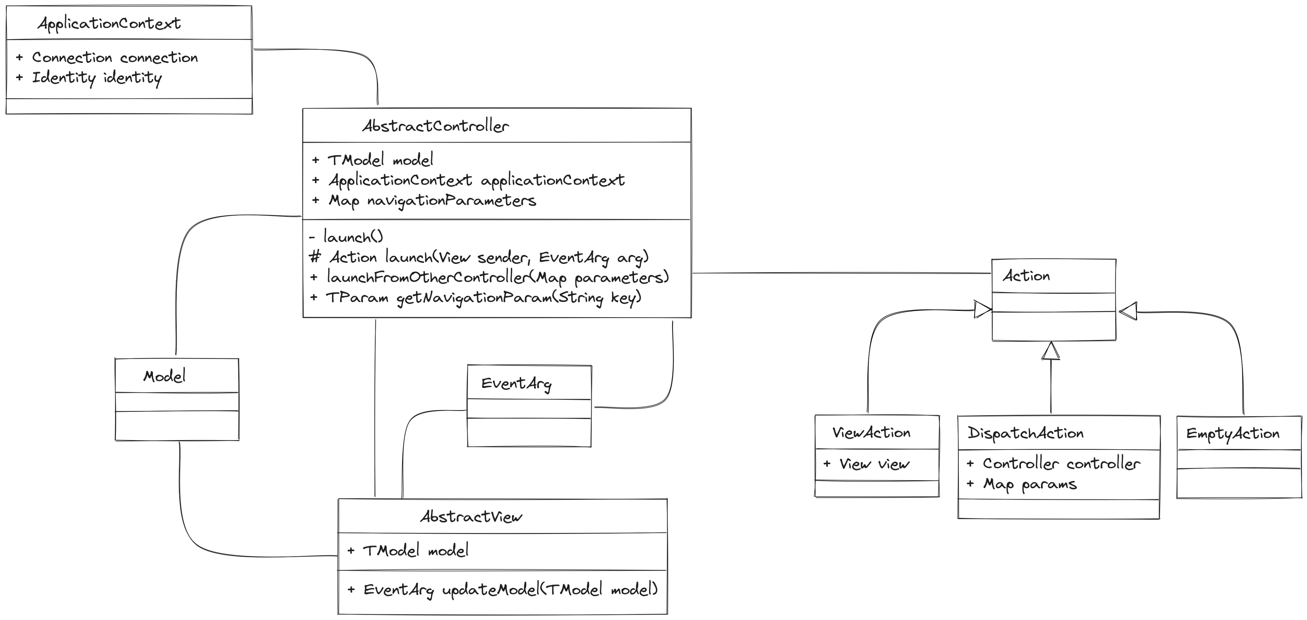
The case study

Slide 50

The case study

Slide 51
The case study

Slide 52
The case study

Slide 53
The case study

Slide 54
The case study

Slide 55
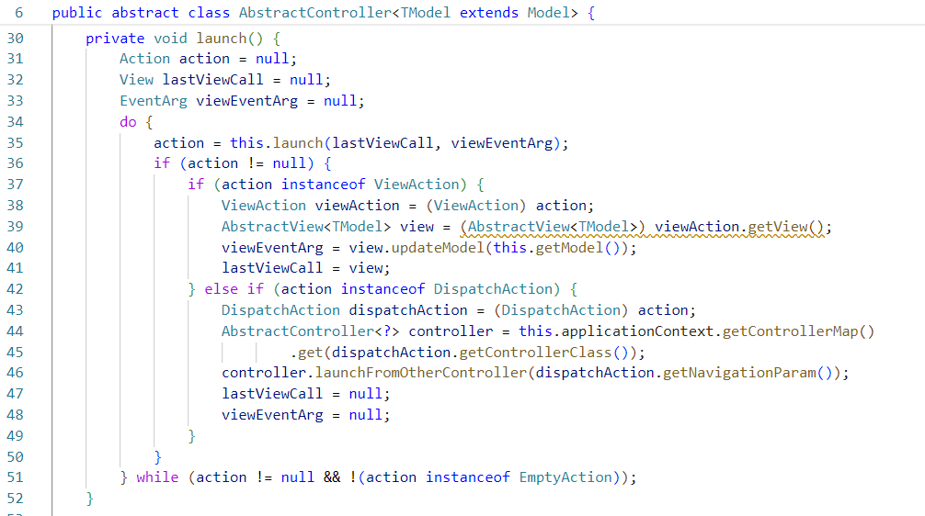
The case study

Slide 56
The case study

Slide 57
The case study

Slide 58
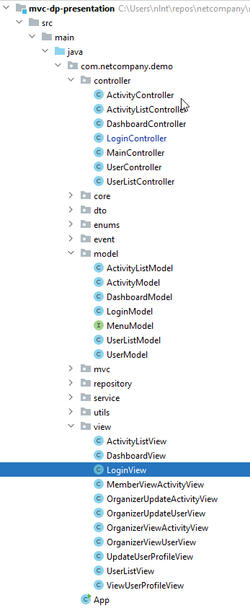
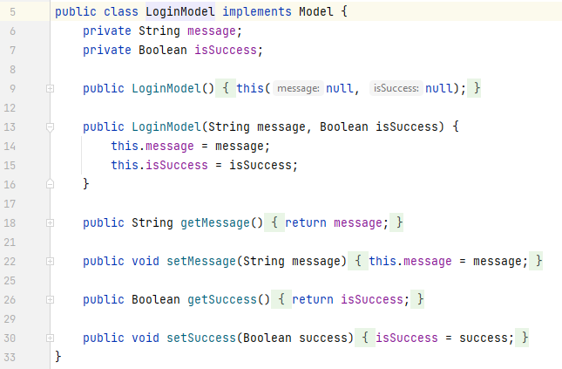
The case study

Slide 59
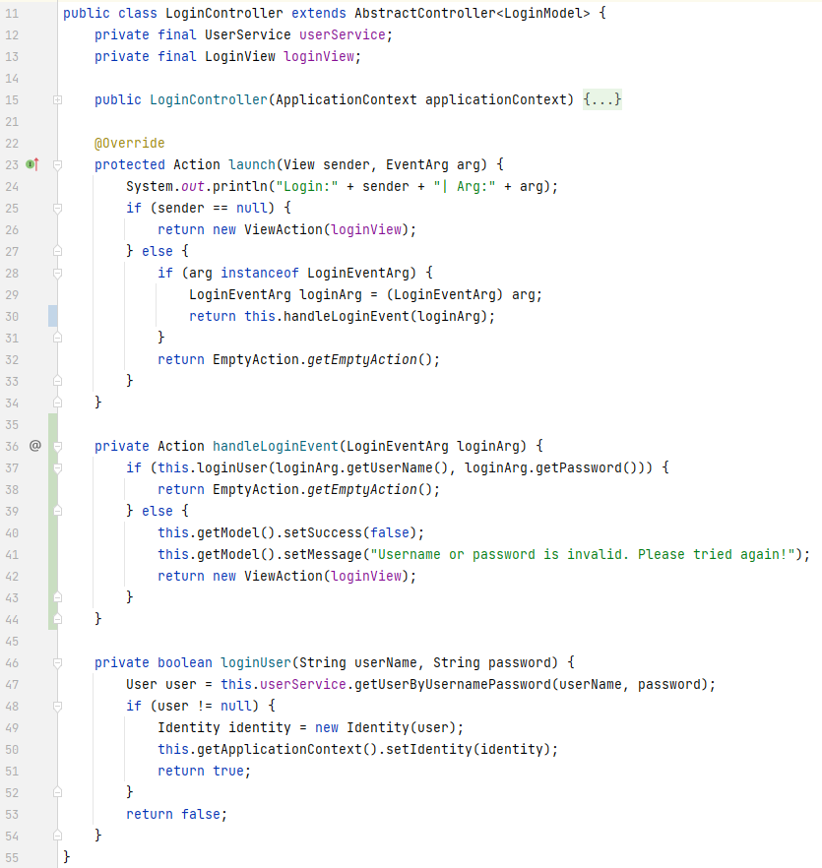
The case study

Slide 60
The case study

Slide 61
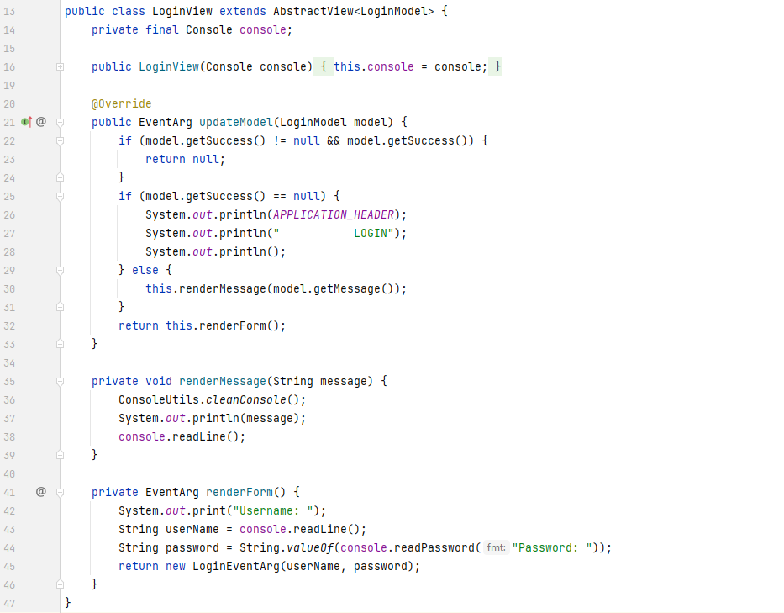
The case study

Slide 62
The case study

Slide 63
Conclusion
Easier for both teams work concurrently.
Easier to reuse the controller logic for multiple views
Easier to comprehend
Needed to change the mindset when coding Controller and View
More complicated in the core layer of the project

Slide 64
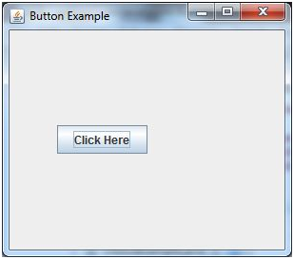
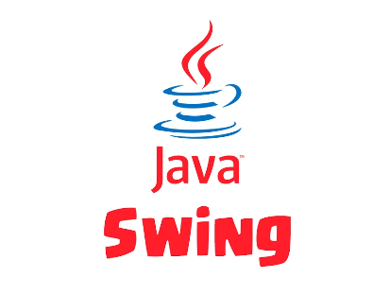
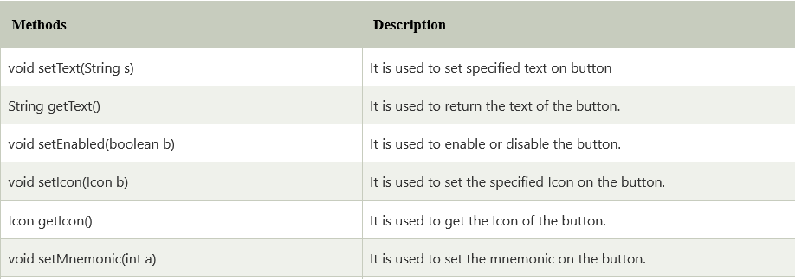
Real world examples

Slide 65
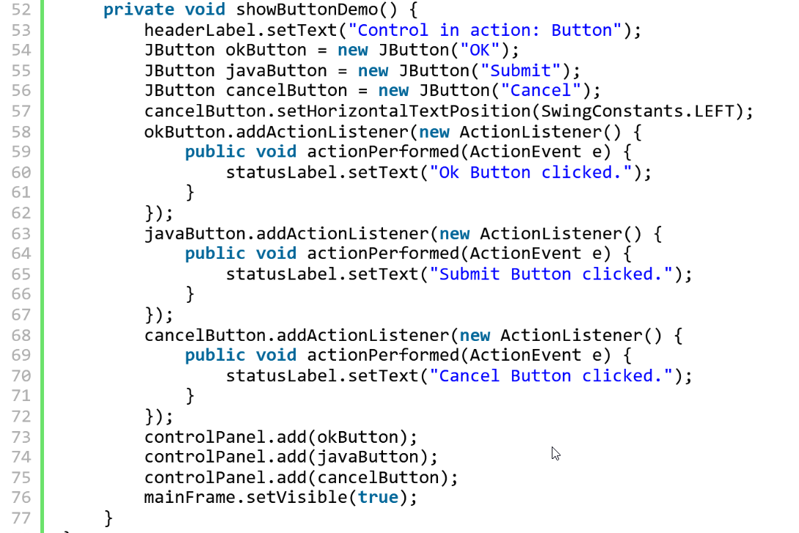
Real world examples

Slide 66
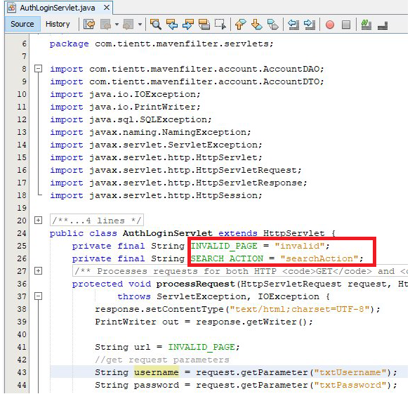

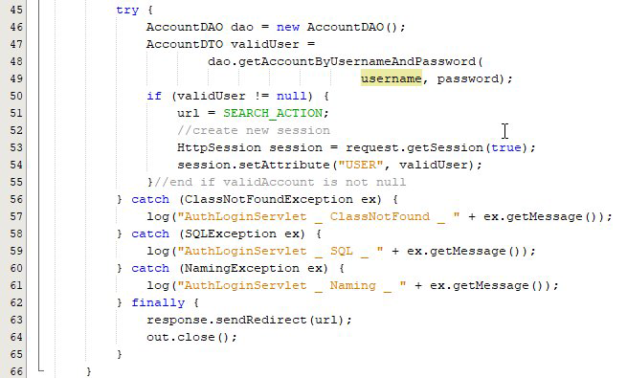
Real world examples

Slide 67
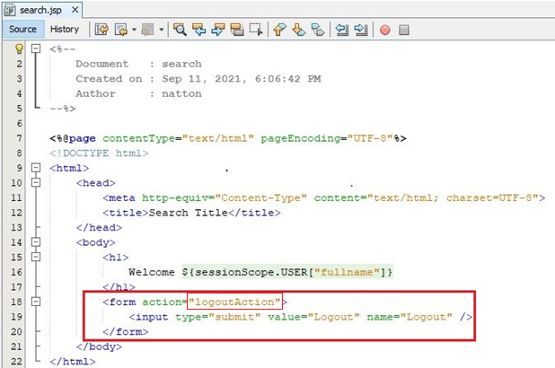
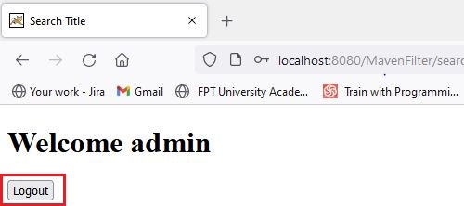
Real world examples

Slide 68
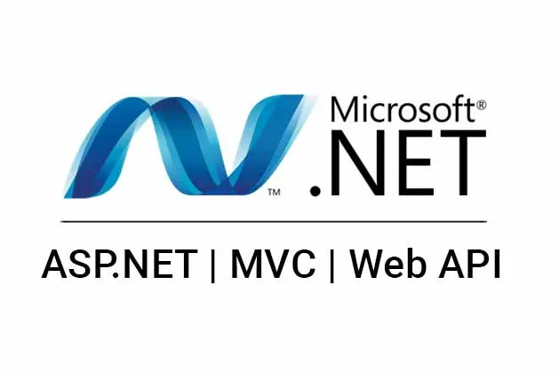
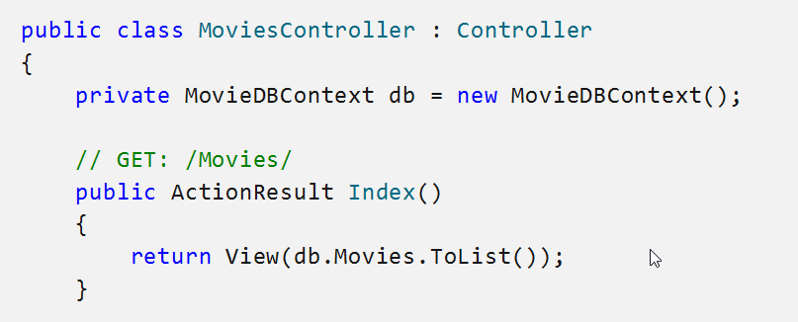
Real world examples

Slide 69
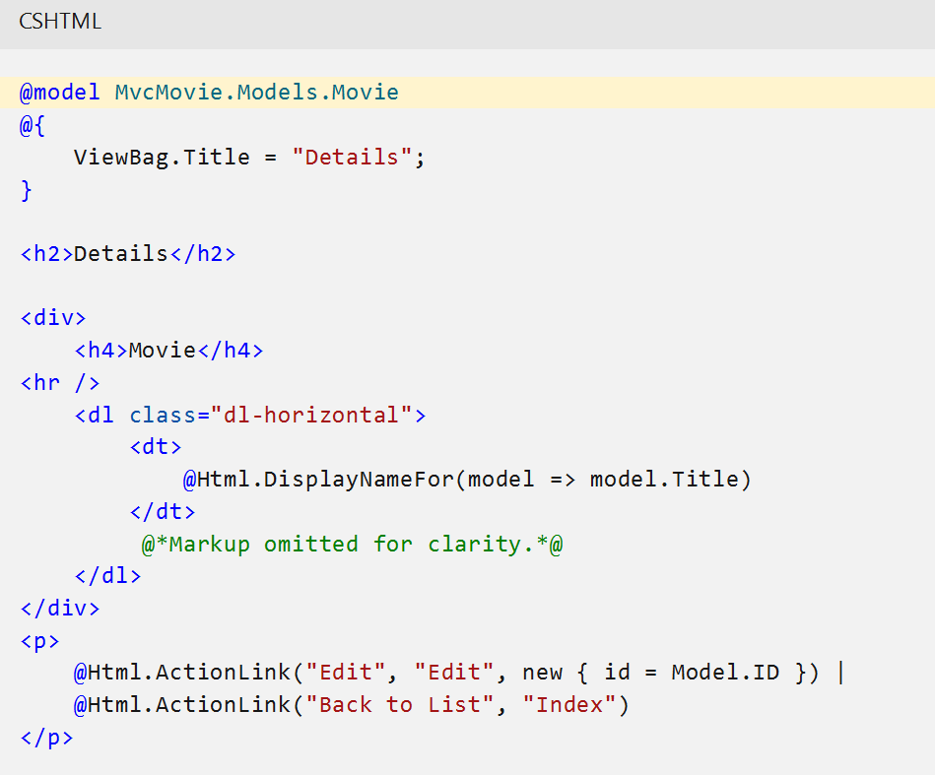
Real world examples

Slide 70
Agenda
Introduction
OOP recap
From OOP to MVC Pattern
Introduction to Design Pattern
Summarize
Q&A

Slide 71
Introduction to Design Pattern
What is Design Pattern?
Notes:
MVC is a design pattern, so what is it?

Slide 72
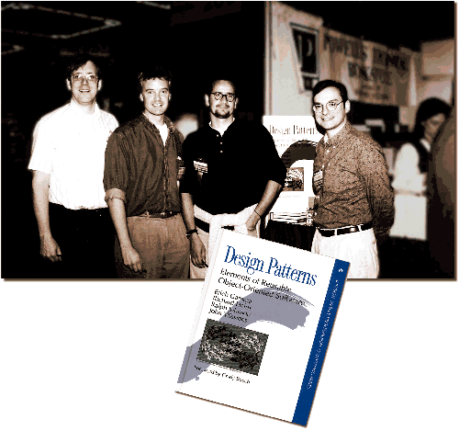
Introduction to Design Pattern
What is Design Pattern?
First introduced in 1994 by the Gang Of Four in the book: Design Patterns - Elements of Reusable Object-Oriented Software.
The pattern is not a specific piece of code, but a general concept for solving a particular problem. You can follow the pattern details and implement a solution that suits the realities of your own program.
Notes:
First introduced in 1994 by the Gang Of Four in the book: Design Patterns - Elements of Reusable Object-Oriented Software.
Design patterns are typical solutions to commonly occurring problems in software design. They are like pre-made blueprints that you can customize to solve a recurring design problem in your code.
The pattern is not a specific piece of code, but a general concept for solving a particular problem. You can follow the pattern details and implement a solution that suits the realities of your own program.

Slide 73
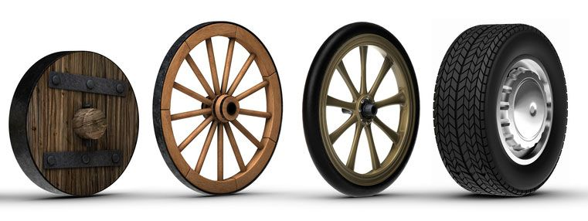
Introduction to Design Pattern
What is Design Pattern?
Notes:
First introduced in 1994 by the Gang Of Four in the book: Design Patterns - Elements of Reusable Object-Oriented Software.
Design patterns are typical solutions to commonly occurring problems in software design. They are like pre-made blueprints that you can customize to solve a recurring design problem in your code.
The pattern is not a specific piece of code, but a general concept for solving a particular problem. You can follow the pattern details and implement a solution that suits the realities of your own program.

Slide 74


Introduction to Design Pattern
What is Design Pattern?
Notes:
First introduced in 1994 by the Gang Of Four in the book: Design Patterns - Elements of Reusable Object-Oriented Software.
Design patterns are typical solutions to commonly occurring problems in software design. They are like pre-made blueprints that you can customize to solve a recurring design problem in your code.
The pattern is not a specific piece of code, but a general concept for solving a particular problem. You can follow the pattern details and implement a solution that suits the realities of your own program.

Slide 75
Introduction to Design Pattern
What is Design Pattern?
Both Algorithms and Design patterns are the solutions to a problem, so how to differentiate them
 | algorithms | patterns
definition | recipe for performing some task | way of structuring code
scope | detail level | high level
Notes:
As both Design patterns and Algorithms resolve problems, the diff between them is: While an algorithm always defines a clear set of actions that can achieve some goal, a pattern is a more high-level description of a solution.

Slide 76
Introduction to Design Pattern
What is Design Pattern?
Most patterns are described very formally so people can reproduce them in many contexts. Here are the sections that are usually present in a pattern description
Intent of the pattern briefly describes both the problem and the solution.
Motivation further explains the problem and the solution the pattern makes possible.
Structure of classes shows each part of the pattern and how they are related.
Code example in one of the popular programming languages makes it easier to grasp the idea behind the pattern.
Notes:
Most patterns are described very formally so people can reproduce them in many contexts. Here are the sections that are usually present in a pattern description:
Intent of the pattern briefly describes both the problem and the solution.
Motivation further explains the problem and the solution the pattern makes possible.
Structure of classes shows each part of the pattern and how they are related.
Code example in one of the popular programming languages makes it easier to grasp the idea behind the pattern.

Slide 77
Introduction to Design Pattern
Three types of design pattern
Notes:
MVC is a design pattern, so what is it?

Slide 78
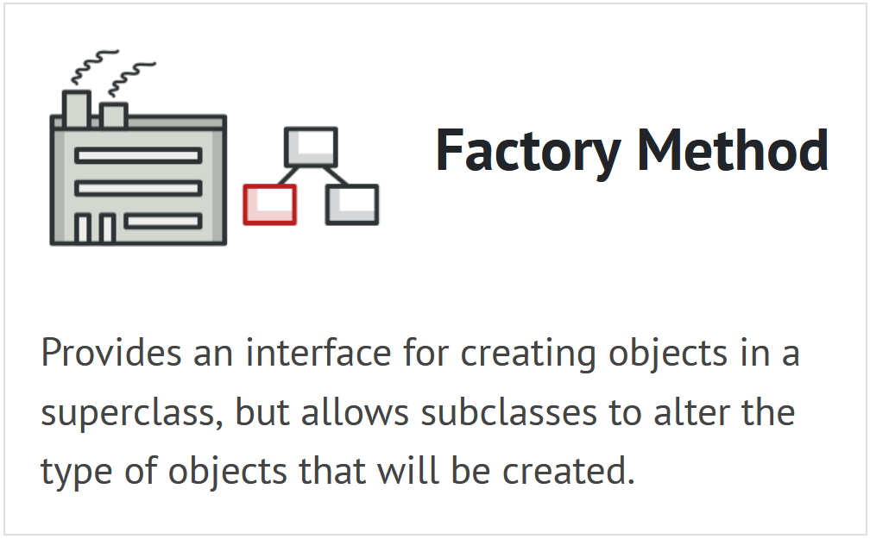
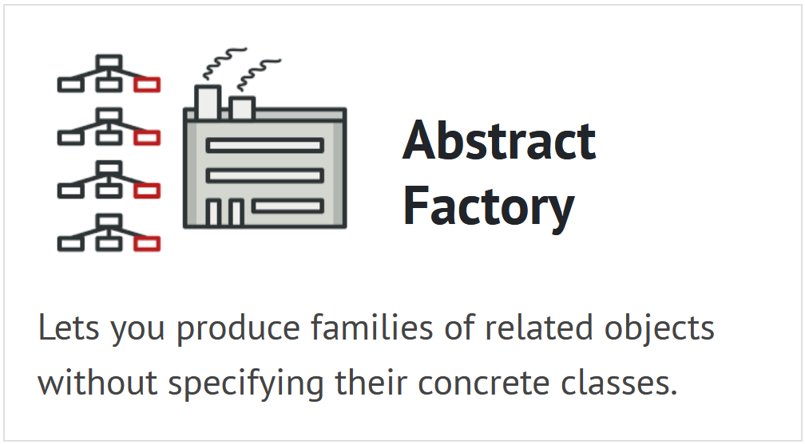
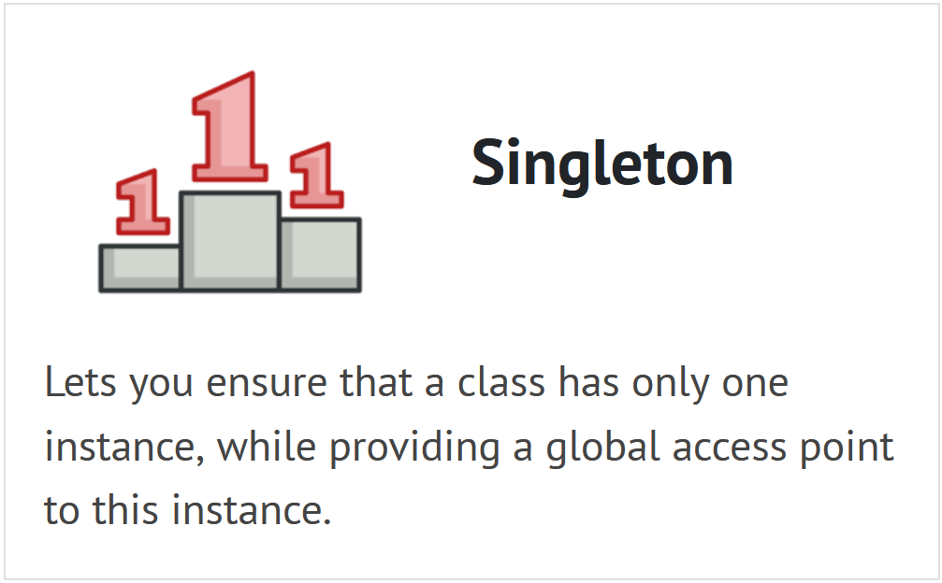
Introduction to Design Pattern
Three types of design pattern
Creational design patterns provide various object creation mechanisms, which increase flexibility and reuse of existing code.
Notes:
Creational design patterns provide various object creation mechanisms, which increase flexibility and reuse of existing code.

Slide 79
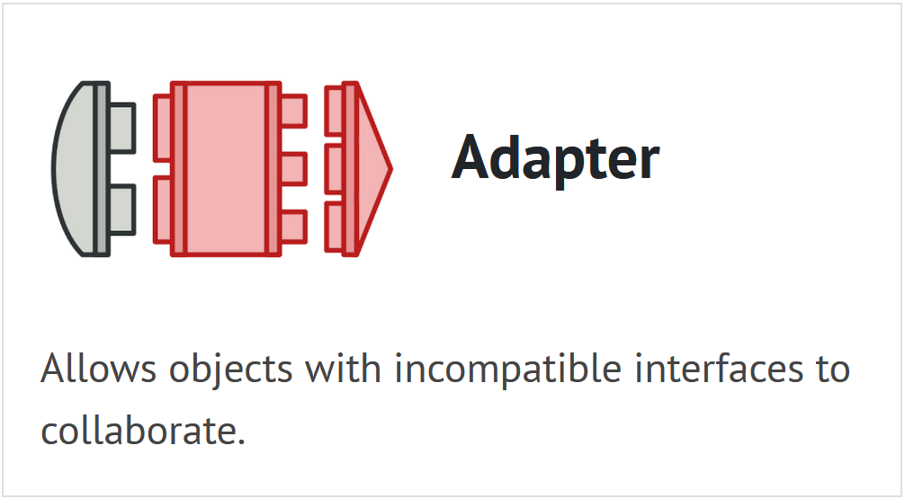
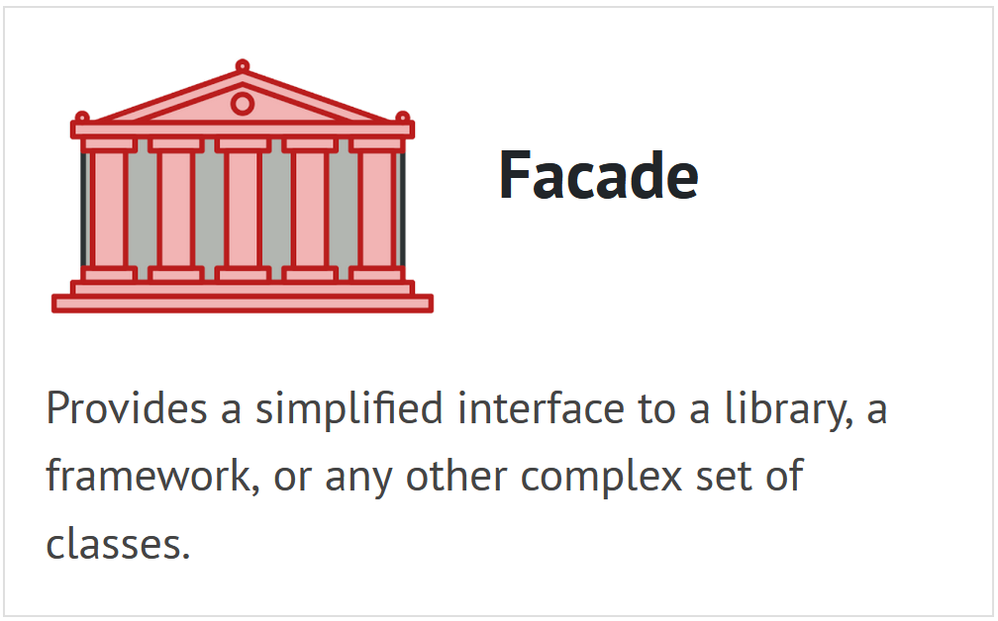
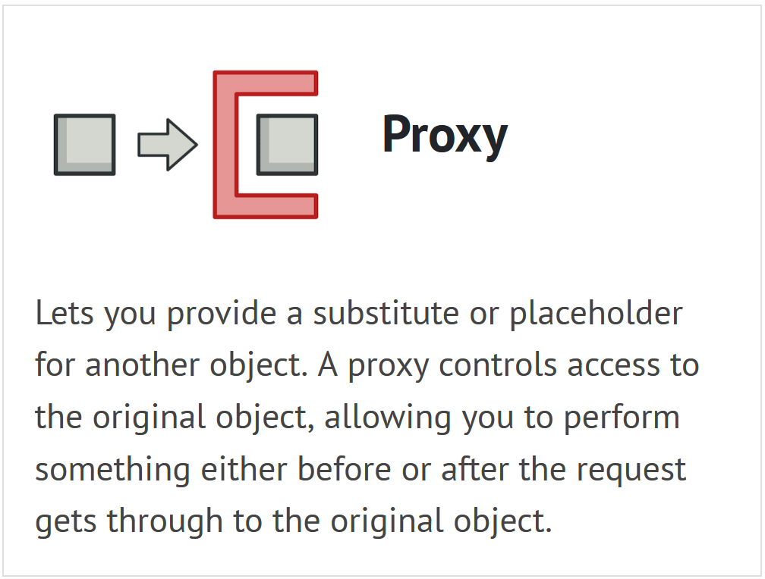
Introduction to Design Pattern
Three types of design pattern
Structural design patterns explain how to assemble objects and classes into larger structures while keeping these structures flexible and efficient.
Notes:
Structural design patterns explain how to assemble objects and classes into larger structures while keeping these structures flexible and efficient.

Slide 80



Introduction to Design Pattern
Three types of design pattern
Behavioral design patterns are concerned with algorithms and the assignment of responsibilities between objects.
Notes:
Structural design patterns explain how to assemble objects and classes into larger structures while keeping these structures flexible and efficient.

Slide 81
Introduction to Design Pattern
How to find and apply a common design pattern
Notes:
MVC is a design pattern, so what is it?

Slide 82





Introduction to Design Pattern
How to find and apply a common design pattern
The idea of Design patterns is solutions to problems. So, you either can use them whenever you meet a problem or just practice the solution to prepare for the problem.
How to apply: apply it when you refactor your code.
Where to find:
https://refactoring.guru/ (⭐)
https://sourcemaking.com/
Books
👉
put it here
Notes:
The idea of Design patterns is solutions to problems. So, you either can use them whenever you meet a problem or just practice the solution to prepare for the problem.
How to apply:
Plan the code
Implementing
Refactor (👈 put it here)

Slide 83
Agenda
Introduction
OOP recap
From OOP to MVC Pattern
Introduction to Design Pattern
Summarize
Q&A

Slide 84
Key takeaways
#1: Model-View-Controller is the concept of encapsulating some data together with its processing and isolate it from the manipulation and presentation.
#2: Design patterns are commonly defined as time-tested solutions to recurring design problems.
#3: Design patterns are represented as relationships between classes and objects with defined responsibilities that act in concert to carry out the solution.
#4: Design pattern misuse could make the project over-complicated and slow.

Slide 85


Resources
https://github.com/truongnln2/mvc-dp-presentation

